Slide 1

Exploring
#8a Lowdb & Express File Upload

Slide 2


?
#1
How to Connect
Express to a Dummy Database

Slide 3
Lowdb
Lowdb is a small local JSON database powered by Lodash, supports Node, Electron and the browser
(See github.com/typicode/lowdb).
Installation
$ npm install lowdb --save

Slide 4
Lowdb
#1 Add Data
const low = require('lowdb')
const FileSync = require('lowdb/adapters/FileSync')
const adapter = new FileSync('db.json')
const db = low(adapter)
db.defaults({ data: [] })
.write()
db.get('data')
.push({ nama: 'Andi', usia: 24})
.write()
* Run this code, then it will
create a db.json with Andi data

Slide 5
Lowdb
#2 Data Counts
const low = require('lowdb')
const FileSync = require('lowdb/adapters/FileSync')
const adapter = new FileSync('db.json')
const db = low(adapter)
db.defaults({ data: [] })
.write()
var jumlah = db.get('data')
.size()
.value()
console.log(jumlah)

Slide 6
Lowdb
#3 Get All Data
const low = require('lowdb')
const FileSync = require('lowdb/adapters/FileSync')
const adapter = new FileSync('db.json')
const db = low(adapter)
db.defaults({ data: [] })
.write()
var all = db.get('data')
.value()
console.log(all)

Slide 7
Lowdb
#4 Get 5 First Data
const low = require('lowdb')
const FileSync = require('lowdb/adapters/FileSync')
const adapter = new FileSync('db.json')
const db = low(adapter)
db.defaults({ data: [] })
.write()
var lima = db.get('data')
.take(5)
.value()
console.log(lima)

Slide 8
Lowdb
#5 Get Specific Data
const low = require('lowdb')
const FileSync = require('lowdb/adapters/FileSync')
const adapter = new FileSync('db.json')
const db = low(adapter)
db.defaults({ data: [] })
.write()
var ambilData = db.get('karyawan')
.find({nama:'Budi'}).value()
console.log(ambilData)

Slide 9
Lowdb
#6 Get Specific Data Props Value
// hapus data ->
db.get('karyawan')
.remove({kota:'Jakarta'})
.write()
// edit data
db.get('karyawan')
.find({ nama:'Andi'})
.assign({ nama:'Al' })
.write()

Slide 10
Lowdb
#7 GET
Express
const express = require('express');
const app = express();
const low = require('lowdb');
const FileSync = require('lowdb/adapters/FileSync');
const adapter = new FileSync('db.json');
const db = low(adapter);
db.defaults({ data: [] }).write()
app.get('/', (req,res)=>{
db.get('data').push({nama:'Budi',usia:23}).write();
res.send('Halo Dunia!');
});
app.listen(3000, ()=>{
console.log('Server @port 3000!');
});

Slide 11
Lowdb
#8 POST & GET
Express
Part 1
const express = require('express');
const app = express();
const bodyParser = require('body-parser');
const low = require('lowdb')
const FileSync = require('lowdb/adapters/FileSync')
const adapter = new FileSync('lowdb_tes.json')
const db = low(adapter)
db.defaults({ data: [] }).write()
app.use(bodyParser.json());

Slide 12
app.get('/',(req,res)=>{
var y = db.get('data').value();
res.send(y);
})
app.post('/',(req,res)=>{
console.log(req.body);
db.get('data').push({
nama: req.body.nama,
usia: req.body.usia}).write()
res.send({
status: 'POST berhasil',
nama: req.body.nama,
usia: req.body.usia
});
})
app.listen(3210, function(){
console.log('Run @port 3210!');
});
Lowdb
#8 POST & GET
Express
Part 2

Slide 13
?
#2
How to Create
a Simple File
Upload System

Slide 14
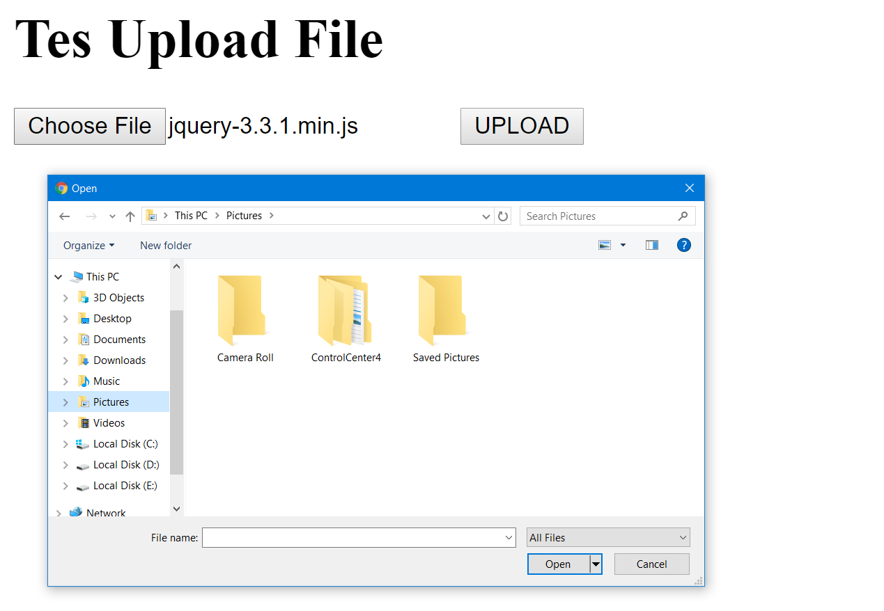

Slide 15
express-fileupload
Simple Express middleware for uploading files. (See npmjs.com/package/express-fileupload).
Installation
$ npm install express-fileupload --save
To use this package, let’s create:
a folder (to store our uploaded files),
a HTML file (front-end), and
a JS file (back-end)!

Slide 16
file-upload.html
<h1>Tes Upload File</h1>
<form method="post" enctype="multipart/form-data" action="/">
<input type="file" name="filename">
<input type="submit" value="UPLOAD">
</form>

Slide 17
file-upload.js
#part 1
var express = require('express');
var app = express();
var upload = require('express-fileupload');
app.use(upload())
app.get("/", function(req,res){
res.sendFile(__dirname+"/file-upload.html")
})

Slide 18
file-upload.js
#part 2
app.post("/", function(req,res){
if(req.files){
console.log(req.files)
var file = req.files.filename;
var filename = file.name;
file.mv("./file-upload/"+filename, function(err){
if(err){
console.log(err);
res.send('<h1>Upload gagal!</h1>');
}
else{
res.send('<h1>Upload sukses!</h1>');
}
})
}
})
app.listen(3210, function(){
console.log('Run @port 3210!');
});

Slide 19
Run file-upload.js & open localhost:3210!

Slide 20
Exploring
#8a Lowdb & Express File Upload

